Slide 1

The Case for Action on Methane in Central Asia
(& Some Resources to Help)
Denise Mulholland
Lead, International Methane Team
Director, Global Methane Initiative Secretariat
US Environmental Protection Agency
7 November 2023

Slide 2
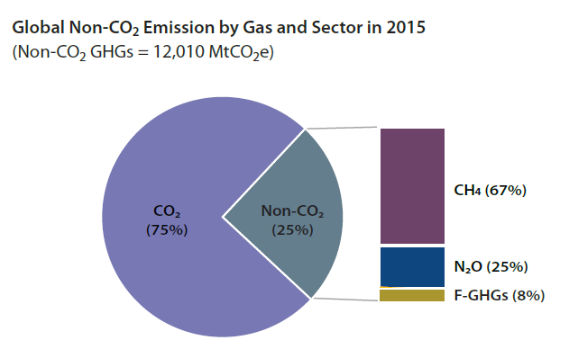
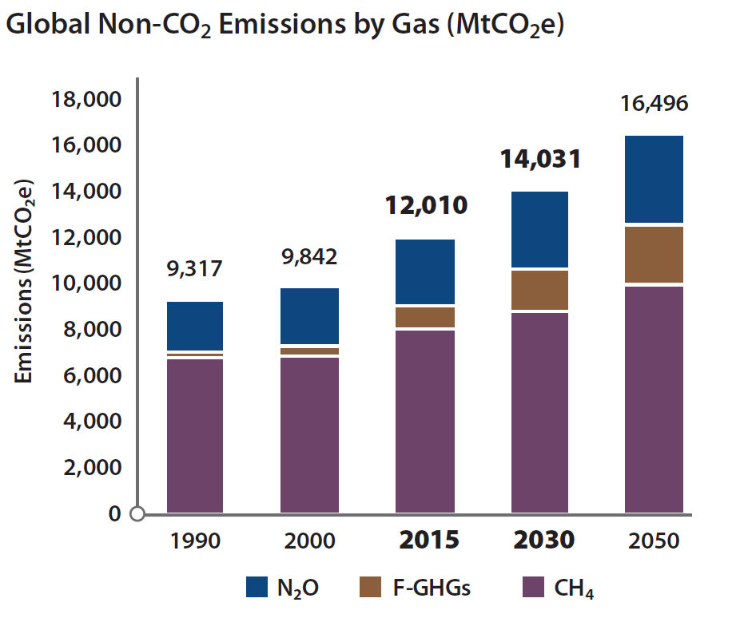
Global Greenhouse Gas Emissions and Methane
Methane (CH4) is a potent greenhouse gas (GHG) that has extreme effects on climate warming.
Source: Global Non-CO₂ Greenhouse Gas Emission Projections & Mitigation: 2015-2050, USEPA 2019
Notes:
Methane accounts for approximately 10% of anthropogenic, or human-influenced, greenhouse gas emissions It is the second most abundant GHG behind carbon dioxide.

Slide 3
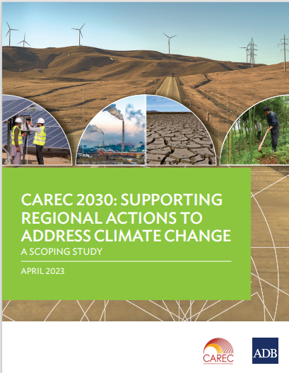
Central Asia and Climate Change
Central Asia is already feeling the effects of climate change, according to a scoping study produced by the Asian Development Bank in 2023:
Water Scarcity:
Over the past 50–60 years, the area of glaciers in Central Asia has decreased by 30%
  Freshwater in Central Asian basins is projected to decrease between 10-40% in next 75 years
Increased intensity and frequency of storms
Melting snowcaps plus intensifying extreme weather events are triggering natural calamities, including the increasing frequency and severity of floods and landslides
Increased Desertification:
The shortage of water resources, increase in temperature, high variability of precipitation, extreme heat spells, and deforestation lead to increased desertification.
  ABD estimates that 4%–10% of cultivated areas, 27%–68% of pastures, and 1%–8% of forests are currently significantly degraded in Central Asia and are subject to desertification.
Other Important Considerations
The population is growing rapidly which will only increase demand for natural resources
Air pollution is already a challenge for Central Asia with poor air quality in cities, especially in the winter.
Source: CAREC 2030: Supporting Regional Actions to Address Climate Change, ADB, April 2023
Notes:
Growing water scarcity negatively affects essential economic sectors such as energy, agriculture, and food security, and creating potential conflict.

Slide 4
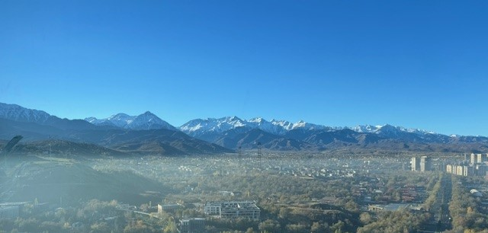
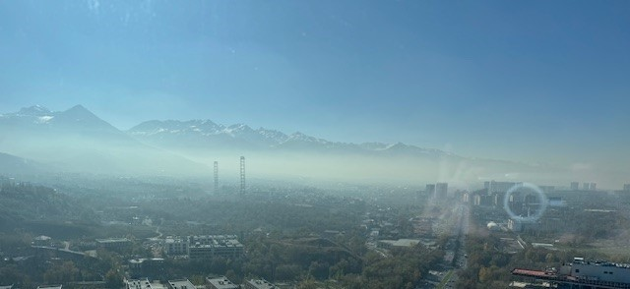
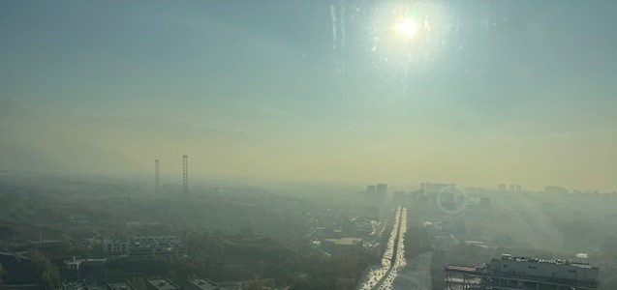
Methane and Air Quality
Methane contributes to the formation of ground-level ozone - smog
Ozone has been associated with
  Respiratory illnesses and hospitalizations
  Cardiovascular disease
  Asthma and related Emergency room visits
  Lost work and school days
  Restrictions on activity
  Premature death
Reducing methane can improve air quality and human health

Slide 5

Why Methane Matters
Positive Outcomes
of Capturing
and Using Methane
Better air and water quality
Improved human health
Increased worker safety
Enhanced energy security
Economic growth
Reduced odors
Methane Emissions
Trap 28 times more heat than carbon dioxide over 100 years
Contribute to ground- level ozone pollution
Create industrial safety problem
Methane Mitigation
Opportunity to capture and convert methane to useful energy
Notes:
Why does methane matter?
Methane is a potent greenhouse gas. Methane's lifetime in the atmosphere is much shorter than carbon dioxide, but it is more efficient at trapping radiation. Pound for pound, the comparative impact of methane is more than 28 times greater than CO₂ over a 100-year period.
Methane is the main precursor of ground level ozone pollution and is also an industrial safety problem.
On the flip side, there are cost effective opportunities and technologies to reduce methane emissions, and there are many benefits to doing so – economically, from an environmental perspective, and from a safety perspective --- including – and Ill just name a few:
Better air and water quality,
Increased worker safety,
Economic growth, and
Reduced odors.
Taking steps to reduce methane in the atmosphere by implementing mitigation options for methane emissions is a critical way to reduce the warming of the climate and as well as the harmful impacts of methane emissions on our communities.

Slide 6
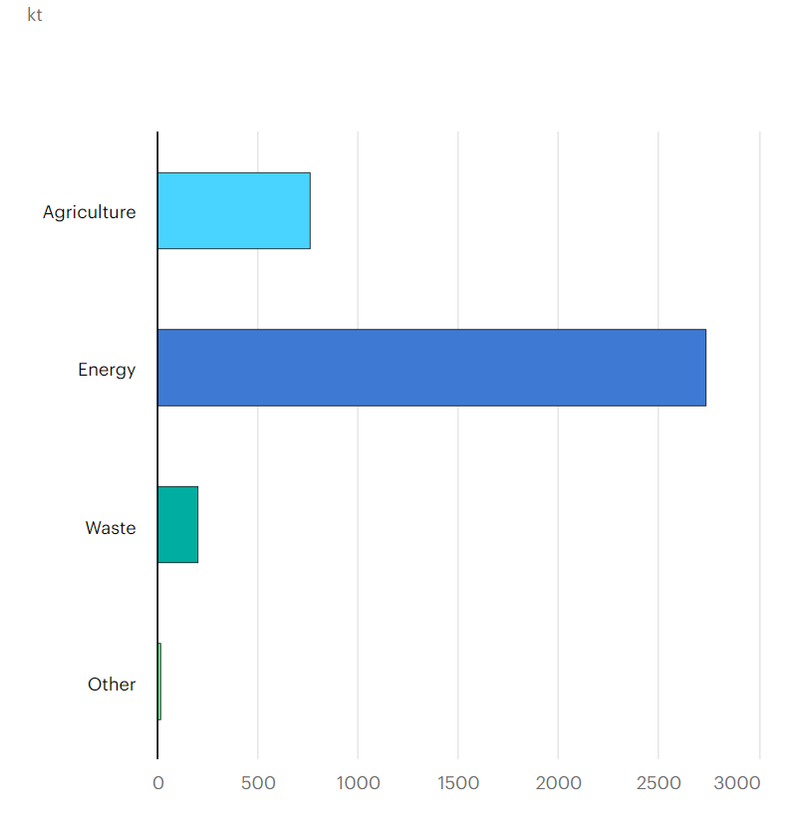
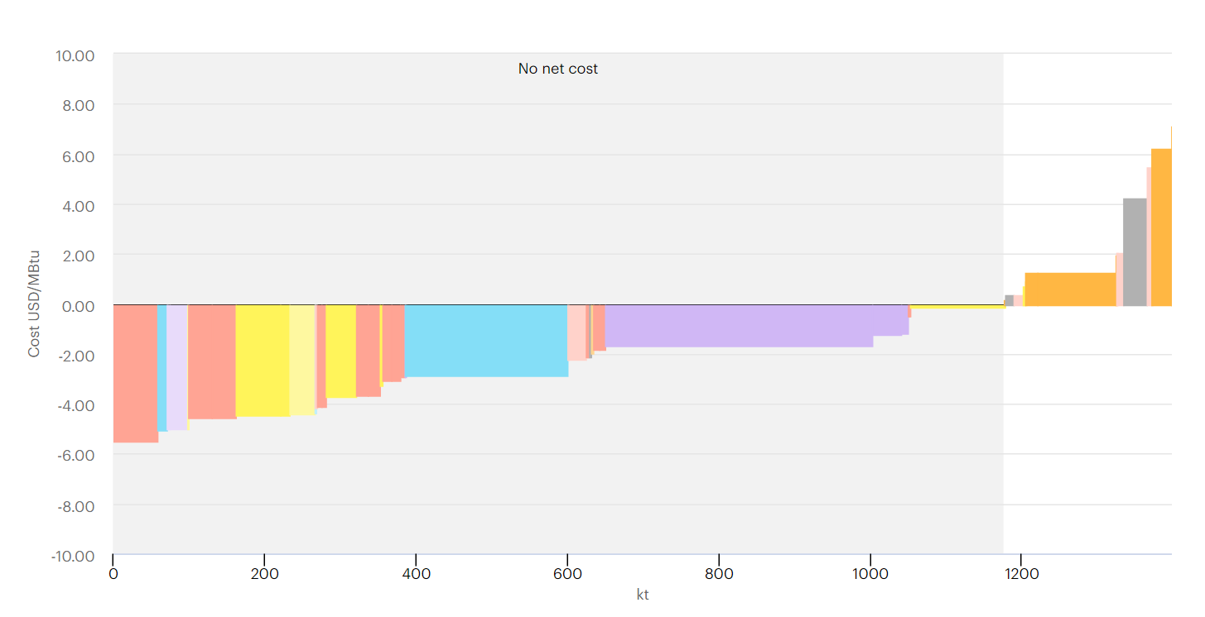
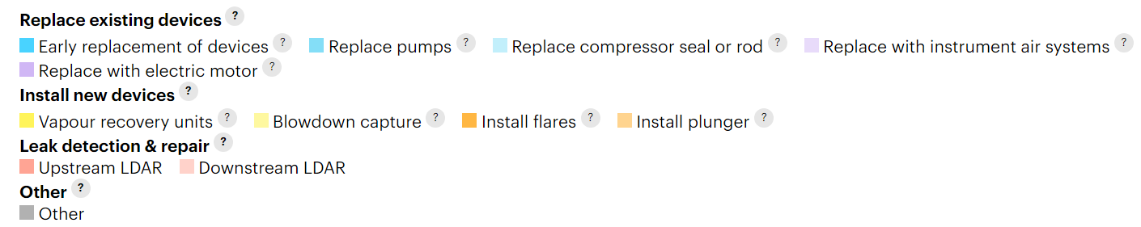
Kazakhstan Methane Emissions and Reduction Potential
Methane emissions in Kazakhstan, by sector, 2022
Oil & gas methane abatement potential in Kazakhstan, by measure
Source: International Energy Agency (2023), Methane Tracker Database, IEA, Paris.
Notes:
Methane is a hydrocarbon with a chemical formula of CH4 that is emitted during the production and transport of coal, natural gas, and oil, in addition to agriculture, land use, and waste management activities. The concentration of methane in the atmosphere has more than doubled since preindustrial times, reaching over 1,800 parts per billion in recent years predominantly due to fossil fuel use and agriculture.

Slide 7
What’s needed? Policies, Measures and Technical Capacity
There are many policies and measures countries can implement to speed up the adoption of technologies and practices that reduce methane emissions
  Regulations/Command and Control: Minimum standards, technology or practice requirements or prohibitions; “emission per output” requirements
  Market-based/Economic: taxes, fees, carbon pricing, trading systems, incentives, subsidies
  Information-based: measurement and reporting requirements, disclosure requirements
  Voluntary programs: with industry, subnationals
Key considerations:
  Engage key stakeholders
  Establish realistic goals
  Explore your legal and regulatory frameworks (e.g. constraints, authorities)
  Evaluate policies that can support and existing policies that may undermine goals
  Consider finance mechanisms and options early
  Learn from others’ experiences; no need to reinvent the wheel
  Build capacity for success

Slide 8
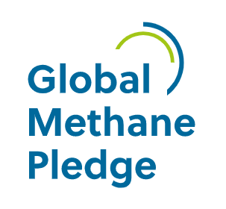
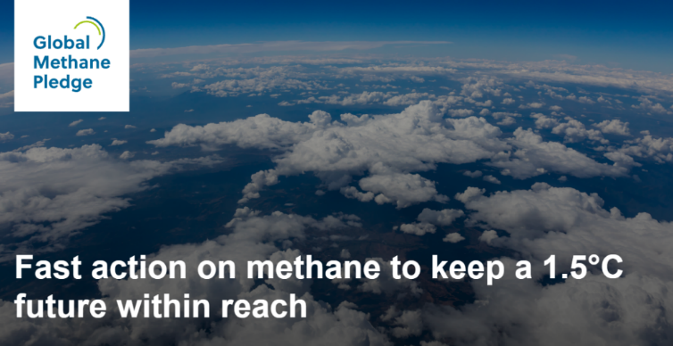
Global Methane Pledge as a Driver
What it is: Voluntary pledge by countries to achieve ambitious global methane reductions:
  Countries commit to work to achieve a collective goal of reducing global methane emissions by at least 30% from 2020 levels by 2030, AND
  Move towards using the highest tier good practice inventory methodologies, and to provide greater transparency in key sectors
Launched by the US and EU at COP26 in November 2021
  Has grown to more than 150 countries that have committed, representing nearly 50% of global anthropogenic methane emissions
Who Supports it:
  Climate & Clean Air Coalition (CCAC) hosted by United Nations Environment Program (UNEP) serves as “secretariat”
  CCAC supports implementation along with others, including but not limited to the Global Methane Initiative
https://www.globalmethanepledge.org/
Notes:
Note: Global Methane Pledge is NOT committing each country to reduce their own methane emissions 30% by 2030

Slide 9
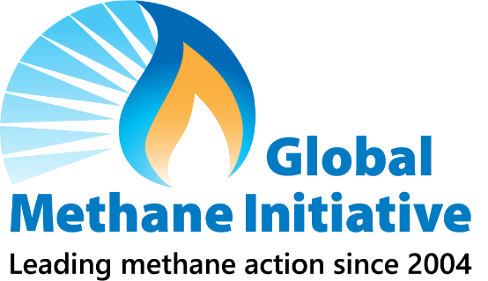
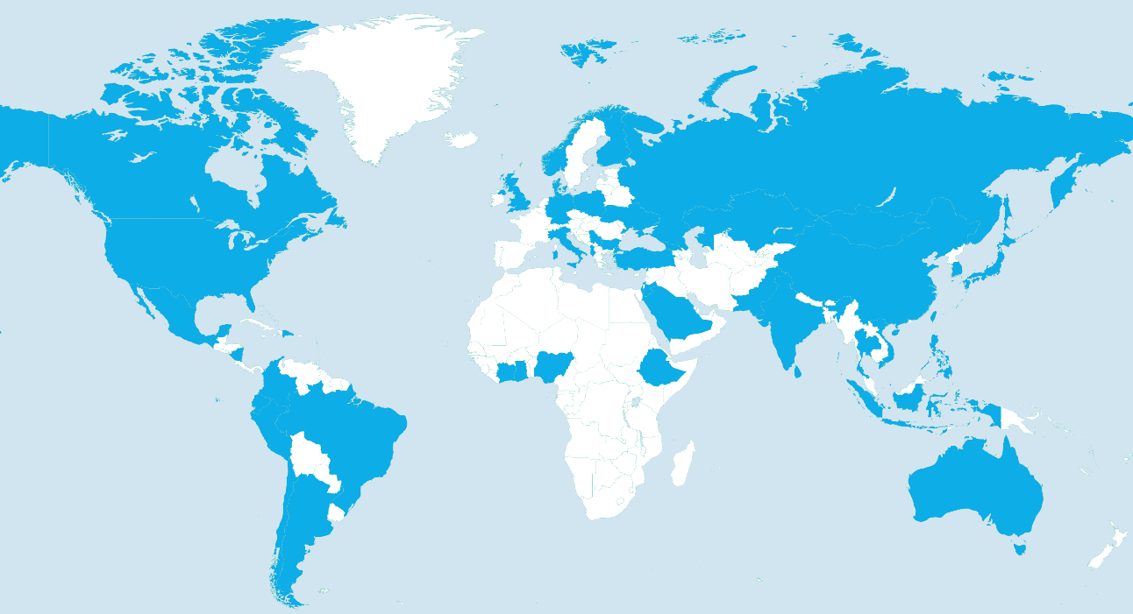
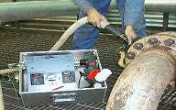
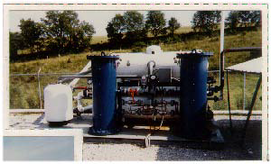
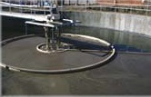
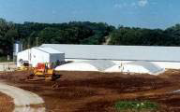
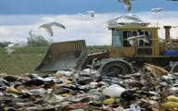
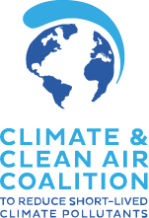




Global Methane Initiative (GMI)
GMI: an international partnership of 47 countries and hundreds of private sector and multilateral partners
Unique expertise, tools, and resources that enable countries to reduce methane quickly and cost-effectively across key sectors:
Municipal Solid Waste
GMI Partner Countries
Oil & Gas Systems
Coal Mines
Wastewater
Agriculture: manure
www.globalmethane.org
Strategic Alliances
Notes:
GMI is an international public-private initiative, launched in 2004 as the Methane to Markets Partnership.
GMI’s mission is to advance cost-effective, near-term methane abatement and recovery and use of methane as a valuable energy source in three sectors: biogas (including agriculture, municipal solid waste, and wastewater), coal mines, and oil and gas systems
The Global Methane Initiative (GMI) has a proven and unparalleled track record of developing and disseminating technical expertise, tools, and resources
GMI has enabled countries to reduce methane quickly and cost-effectively, by working with countries to develop methane mitigation strategies, action plans, policies, tracking methods, and best practices to achieve national level emissions reduction goals.
Since 2004, GMI has partnered with 45 countries and hundreds of private sector and multilateral partners, reducing methane emissions by more than 450 MMTCO₂E.

Slide 10
GMI Actions and Resources to Support Methane Reductions
Performs Assessments and Provides Tools | Builds Capacity with Best Practices and Guidance | Fosters peer exchange and information sharing
Desktop studies Site Visits and scoping missions On-site measurement (i.e Pre-Feasibility) studies Leak Detection and Repair Data collection assistance Reports/Technical Presentations/ Guidance Tools/Models Databases on projects Analyses | Mitigation technologies and best practices Best practices and technologies for measurement, reporting and verification (MRV) Guidance to refine emissions inventories Trainings Consultations | Conferences Presentations to Partners and Other Stakeholders Subcommittee Meetings Workshops Webinars Other Meetings
For more information: www.globalmethane.org

Slide 11
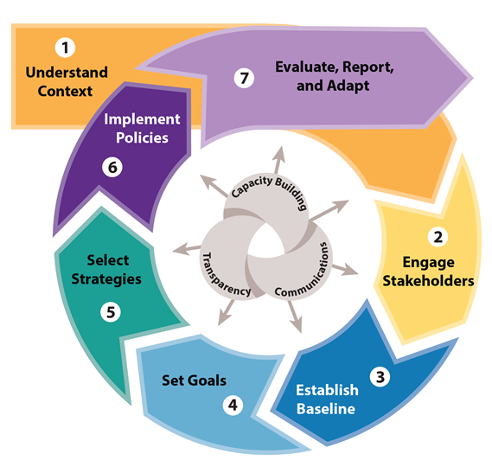
New! GMI Policymaker’s Framework for Addressing Methane Emissions
What: A framework to help countries accelerate progress toward their methane emission reduction goals across all sectors
How:
  Lays out a step-by-step process for developing and implementing policies, programs, and partnerships to reduce methane emissions
  Compiles and organizes available tools, resources and case studies – generally and sector-specific - around seven steps
  Outlines three core principles for success
    Capacity building, transparency and communications
Who: Primarily for national policymakers
When: Mid-November 2023
Where: www.globalmethane.org

Slide 12
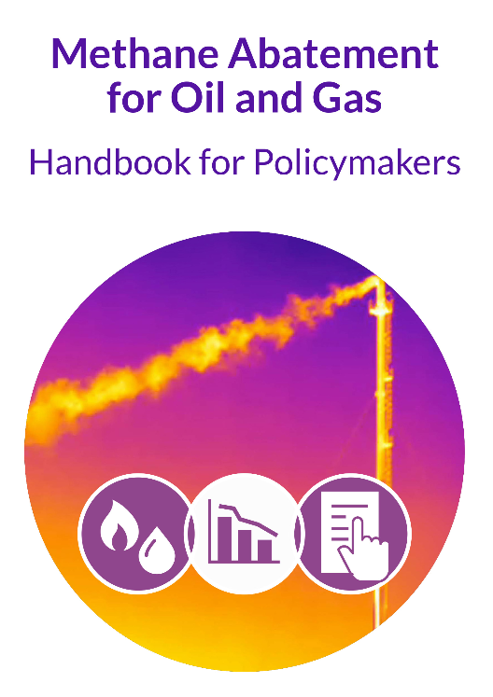

New! Methane Abatement for Oil and Gas:
Handbook for Policymakers
- A ‘how-to’ action guide to policymakers to adopt and enforce legal instruments to rapidly and effectively reduce methane emissions from the Oil and Gas sector.
- Sponsored by U.S. Department of State, Bureau of Energy Resources.
Drafted by 13 expert co-authors from government (U.S., Sri Lanka, and Bangladesh), NGOs, multilateral institutions (IEA, The Commonwealth), industry, and academia
Available here: https://cldp.doc.gov/methane-abatement-resources
IMPROVING THE LEGAL ENVIRONMENT FOR BUSINESS WORLDWIDE U.S. Department of Commerce | CLDP
Notes:
1/ The Handbook seeks to add transferable, straightforward guidance on options for developing legal instruments - the laws, rules, and/or contract clauses - that officials can put in place now to practically reduce methane.
2/ There is already broad consensus among the more responsible industry players and climate and energy policy makers on how countries can reduce methane emissions in the O&G sector. The technologies and practices - such as better pneumatic pumps, Leak Detection and Repair (LDAR), flaring restrictions - exist and are well-known.
3/ The Handbook sets the stage for bilateral technical assistance.

Slide 13
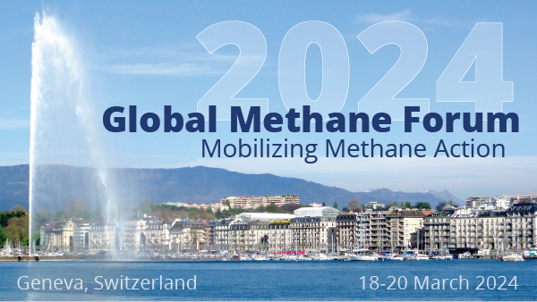
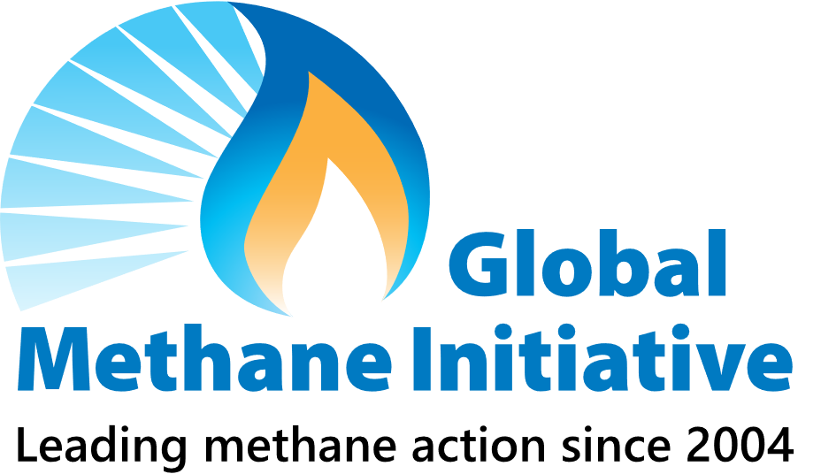



Save the date!
2024 Global Methane Forum: Mobilizing Methane Action
Goals:
  Convene global government, science, industry and finance thought leaders to mobilize ambitious action on methane
  Highlight methane mitigation activities underway to achieve the goals, including of the Global Methane Pledge
  Share information about technical, policy, financing, and regulatory challenges and solutions related to methane policy and project development
Dates and Location:
  18-20 March 2024, UN Palais des Nations, Geneva, Switzerland
Additional information will be posted here:
  https://www.globalmethane.org/2024forum and at https://unece.org/sustainable-energy.
Geneva, Switzerland
Week of 18 March 2024
We look forward to welcoming you in Geneva!
Notes:
This concludes my presentation for today, but I did want to end by sharing an upcoming event, in March 2024.
GMI is co-hosting the upcoming Global Methane Forum with the United Nations Economic Commission for Europe in collaboration with the Global Methane Hub and Climate and Clean Air Coalition.
GMI is co-hosting the Global Methane Forum with the United Nations Economic Commission for Europe.
This Forum is an opportunity for global thought and industry leaders to convene and promote replicable methane mitigation successes and mobilize action to continue making progress toward addressing methane.
More information about the forum will be posted on www.globalmethane.org/2024forum
Please sign up for the GMI Mailing List to receive updates about the forum.
We look forward to welcoming and meeting you in Geneva!

Slide 14
Thank You
Denise Mulholland
Mulholland.Denise@epa.gov

